Slide 1




INVESTOR PRESENTATION
1

Slide 2


DISCLAIMER
Information Contained in this Presentation
This presentation (the “Presentation”)is a summary description of Alcon Silver Corp. (“Alcon” or the “Company”) and its business and does not purport to be complete.
Cautionary Note Regarding Forward-Looking Information
This Presentation includes “forward-looking statements” and “forward-looking information” within the meaning of Canadian securities legislation. All statements included in this Presentation, other than statements of historical fact, are forward-looking statements. When used in this presentation, words such as “may”, “would”, “could”, “will”, “intend”, “expect”, “believe”, “plan”, “anticipate”, “estimate”, “scheduled”, “forecast”, “predict”, “foresee” and other similar terminology, or sentences/statements that certain actions, events or results “may”, “could”, “would”, “might” or “will” be taken, occur or be achieved are intended to identify forward-looking statements, which, by their very nature, are not guarantees of the Company’s future operational or financial performance. These statements reflect the Company’s current expectations regarding future events, performance and results, and are accurate only at the time of this Presentation and may be superseded by more current information. Forward-looking statements also involve known and unknown risks, uncertainties and other factors, which may cause the actual results, performance or achievements of the Company or its mineral projects to be materially different from any future results, performance or achievements expressed or implied by such forward-looking statements or information.
In making such statements, the Company has made assumptions regarding, among other things: general business and economic conditions; the availability of additional exploration and mineral project financing; the supply and demand for, inventories of, and the level and volatility of the prices of metals; relationships with strategic partners; the timing and receipt of governmental permits and approvals; the timing and receipt of community and landowner approvals; changes in regulations; political factors; the accuracy of the Company’s interpretation of drill results; the geology, grade and continuity of the Company’s mineral deposits; the availability of equipment, skilled labour and services needed for the exploration and development of mineral properties; andcurrencyfluctuations.
This Presentation also contains references to estimates of Mineral Resources. The estimation of Mineral Resources is inherently uncertain and involves subjective judgments about many relevant factors. Mineral Resources that are not Mineral Reserves do not have demonstrated economic viability. The accuracy of any such estimates is a function of the quantity and quality of available data, and of the assumptions made and judgments used in engineering and geological interpretation, which may prove to be unreliable and depend, to a certain extent, upon the analysis of drilling results and statistical inferences that ultimately may prove to be inaccurate. Mineral Resource estimates may have to be re-estimated based on: (i) fluctuations in mineral prices; (ii) results of drilling; (iii) metallurgical testing and other studies; (iv) proposed and completed mining exploration programs; (v) the evaluation of exploration and drilling plans subsequent to the date of any estimates; and (vi) the possible failure to receive required permits, approvals and licenses.
A preliminary prospectus containing important information relating to the securities and other information described in this document has been filed with the securities regulatory authorities in certain of the provinces of Canada and is available through SEDAR+. A copy of the preliminary prospectus, and any amendment, is required to be delivered with this document. The preliminary prospectus is still subject to completion. There will not be any sale or any acceptance of an offer to buy securities of Alcon Silver Corp. until a receipt for the final prospectus has been issued.
This document does not provide full disclosure of all material facts relating to the securities offered by the Alcon Silver Corp. Investors should read the preliminary prospectus, the final prospectus and any amendment for disclosure of those facts, especially risk factors relating to the securities offered, before makingan investment decision.
The majority of the exploration results and interpretations presented, including an historical mineral resource in the Princesa Project, were generated by prior explorers including Caracara Silver (NI 43-101 technical report on La Princesa Project, prepared by A. Vachon, 2011) and Solex Resources. The historical mineral resource estimate is not reliable in that a Qualified Person has not done sufficient work to qualify this historical resource estimate as a current mineral resource. Key assumptions, parameters and methods used in preparation of the historical mineral resource are listed in a NI 43-101-compliant technical report on La Princesa Project (Chance, June 24, 2024) available on SEDAR+ or Alcon Silver website. Alcon Silver is not treating this historical resource estimate as a current mineral estimate. The historical mineral resource estimate requires new assay data provided by a program of replicate drill holes in La Princesa mineralization completed under supervision by a Qualified Person in order to upgrade to a current mineral resource.
Technical Information
The scientific or technical information in this Presentation has been prepared under the supervision of and reviewed by Mr. W. Bruce Winfield, M.S., C.P.G., a “qualified person” as defined in National Instrument 43-101 – Standards of Disclosure for Mineral Projects..
2

Slide 3
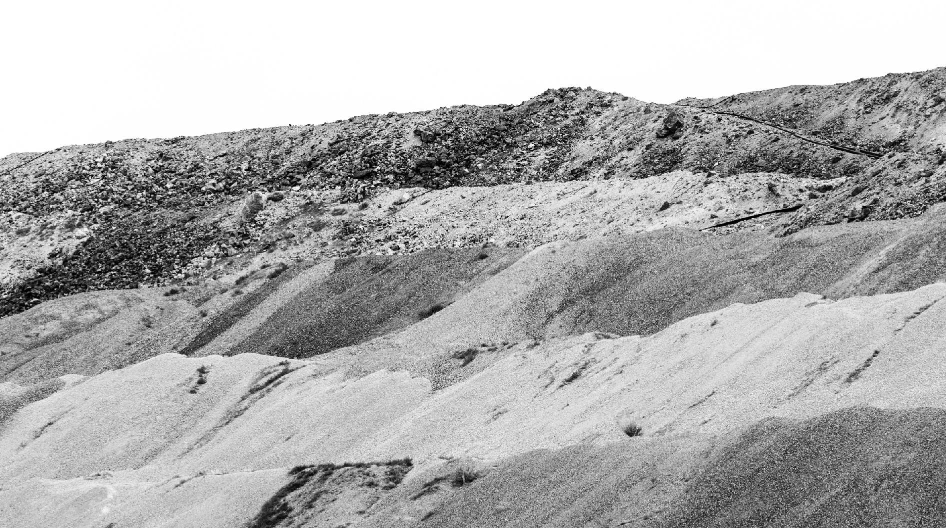








A SILVER DEAL PRIMED FOR ITS DEBUT
Foundational Silver Deposit with Significant Growth Potential
100% Owned Princesa Silver Deposit (historical inferred resource totaling 4.6 million tonnes grading 90.88 g/t Ag, 1.66% Pb and 1.69% Zn)¹
Proven Mine Finders
125 years of exploration and mine development experience predominantly in Latin America including BHP Billiton,
Eldorado Gold, Oz Minerals, and Hochschild Mining
Strong Shareholder Base
Pan American Silver 5%, Management/Insiders 20%, High Net Worth Investors 24%, Newsletter Writers – Social Media Influencers 28%
Tight Share Structure
‘Investor in mind’ mentality with only 36.4M shares outstanding, no options, no warrants, no debt
Blue Sky Upside with Historic Silver CRD District in Utah
First mover advantage with Major Miners now entering CRD camp
1. Alcon Silver Corp. is not treating this historical resource estimate as a current mineral estimate. See Forward Looking Statement, Slide 2.
4

Slide 4
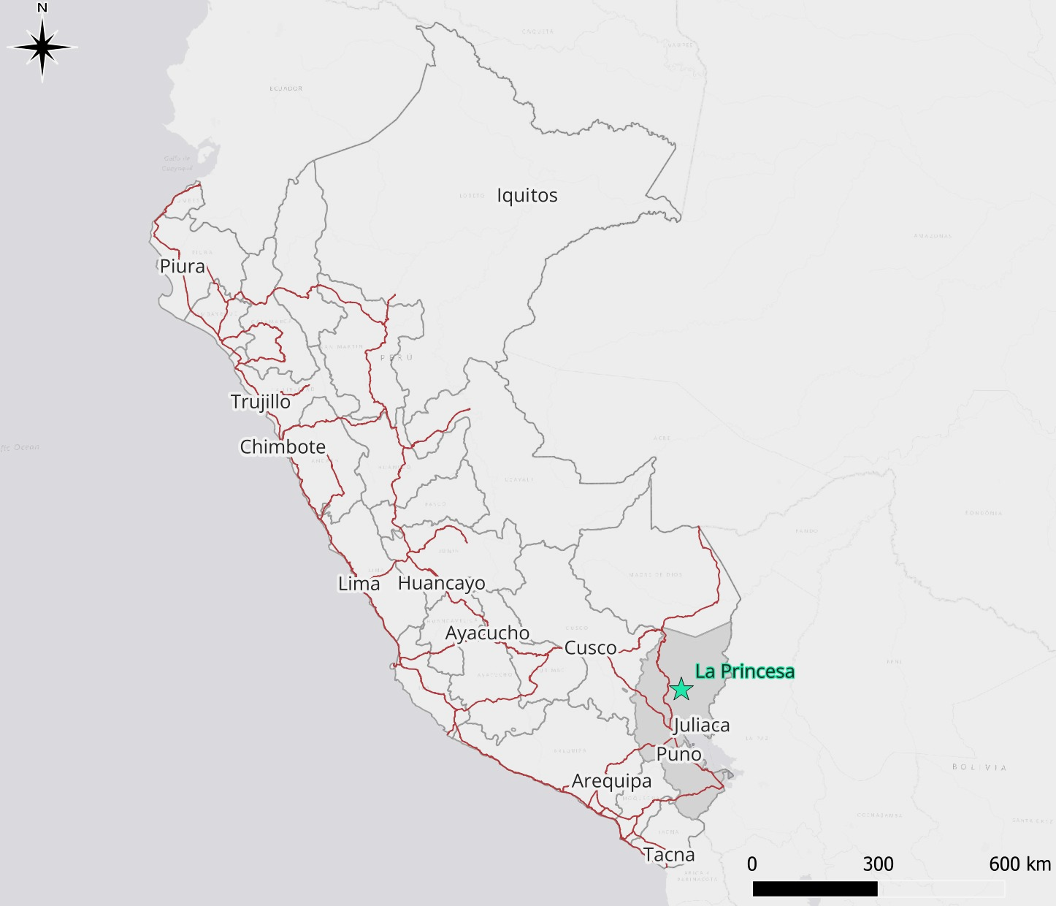

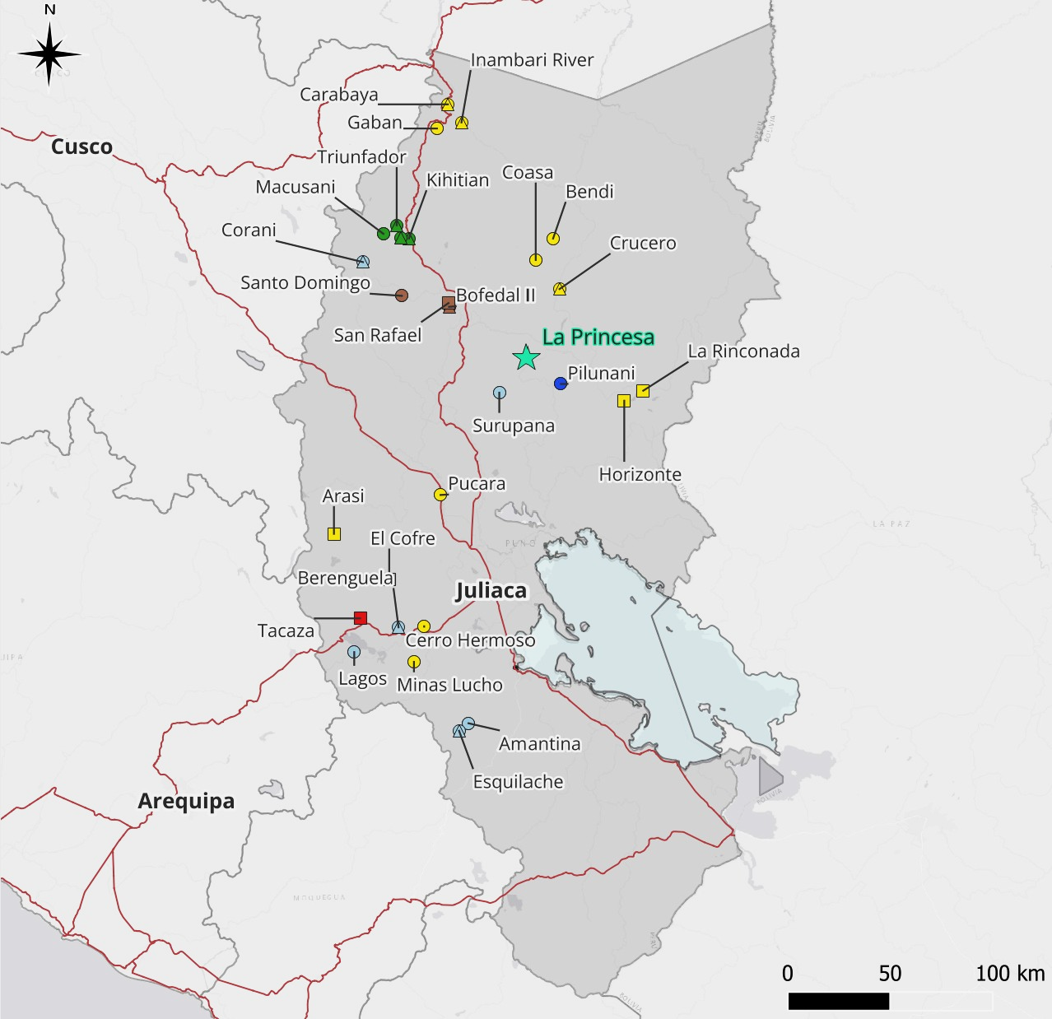
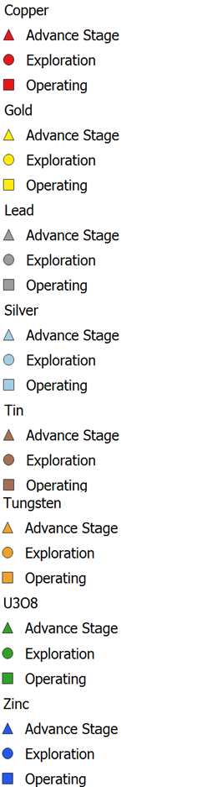


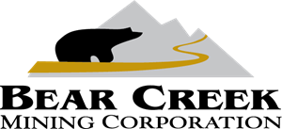


FLOURISHING PUNO-CUSCO MINING REGION
Mineral Projects in the Puno Region
San Rafael largest Tin producer in South America
Corani has Proven and Probable
Reserves of 229M oz Ag grading 51.3 g/t Ag
Berenguela has M&I 101.2M oz Ag grading 78 g/t Ag
Crucero has M&I 993,000 oz grading
1.0 g/t gold³
Lake Titicaca
¹Source: https://bearcreekmining.com/projects/corani/
²Source: https://aftermathsilver.com/projects/berenguela/historic-mineral-resource/
³Source: https://www.goldmining.com/projects/peru/crucero-project/
4

Slide 5

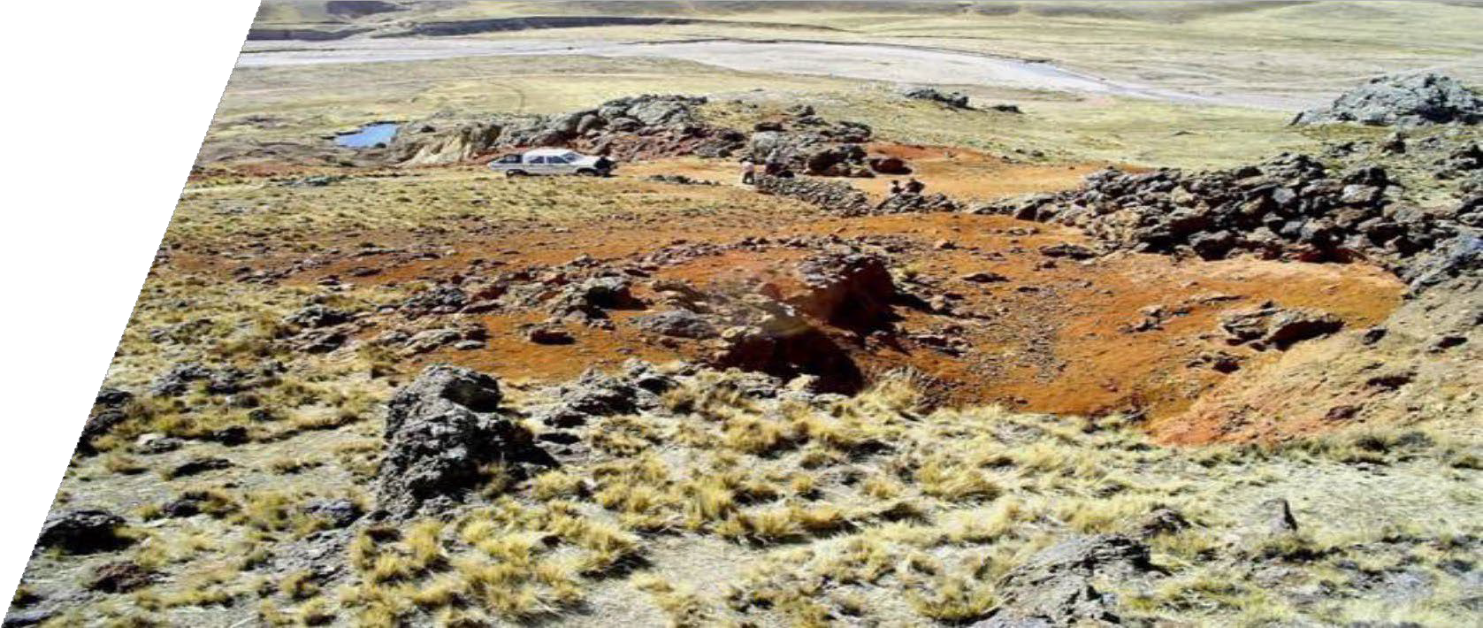
THE FOUNDATIONAL ASSET
PRINCESA SILVER DEPOSIT
5

Slide 6

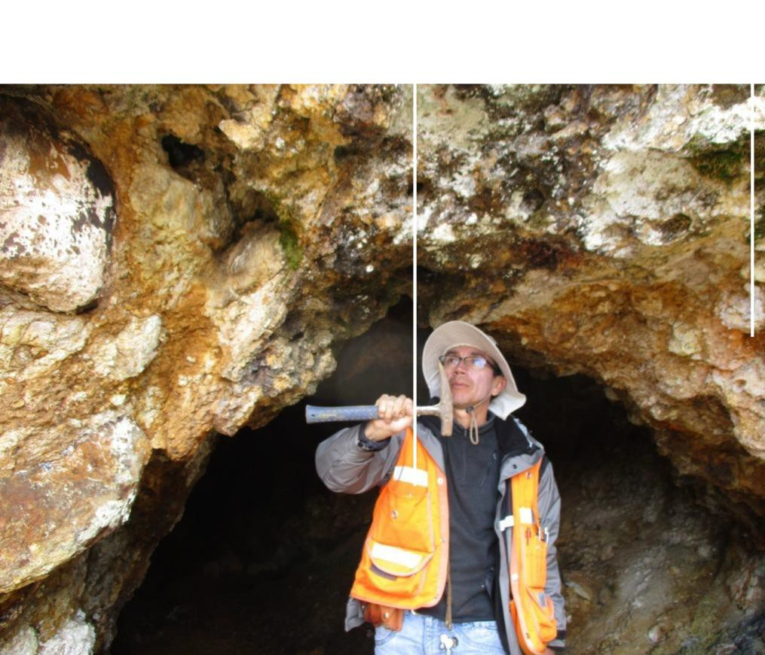

INFRASTRUCTURE AND LOGISTICS
3500 hectare land package
Paved and gravel road access
Excellent social community relations
National electrical grid power and water
access
100% owned and operated
Vein facing east-southeast, showing clayey-looking Huancané conglomerates forming walls to darker, well defined mineralized structure
Regional commercial centre and airport at
Juliaca ~40km, significant local mining expertise

Slide 7
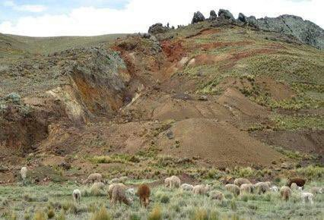
ROBUST HISTORICAL SILVER RESOURCE
¹ Historical Resource is calculated as
in 4.6 m tonnes (90.88 g/t Ag, 1.69% Zn, 1.66% Pb)
The Historical resource envelope only includes 64 holes (out of 82) totalling 8,057 meters (out of 10,300m) drilled along 1.5 km length from 2006 to 2013
Veta La Princesa represents a diatreme-emplaced breccia vein and CRD system over almost 200 m vertically, drilled to 300m depth and traced for almost 2.2 km on surface
Represents an excellent exploration opportunity for both potential to outline resources on the known Veta La Princesa and to discover blind deposits on previously untested structures
Surupana workings immediately west of Río Cullco. Note dumps whose upper surfaces correspondto
This historical resource estimate was stated as an Inferred Mineral Resource in a fully compliant NI 43-101 technical report filed on SEDAR+ on 29-July 2011 by Caracara Silver Inc. (Vachon, 2011). Verification of this historical resource would require additional drilling to confirm historical intersections. The historical estimate was based on 24 out of 64 available diamond drill holes (DDH) when the 2011 technical report was prepared. Data from fifteen (15) DDHs drilled in 2013 not included in the 2011 resource calculation are now available in Caracara’s historical drilling database. Key parameters in the historical resource calculation: minimum true thickness = 1.2m; dip of structure = 60o; specific gravity = 2.75g/cc; radius of influence = half distance to nearest neighbor; high-grade samples not cut. The Caracara 2011 historical resource estimate cannot be relied on due to the destruction of historical drill core, loss of corresponding sampled material (pulps and rejects) and lack of sufficient work by a Qualified Person to assess the validity of the historical estimate. The historical estimate may be validated by completing a series of replicate holes in a future drill program on the property.

Slide 8
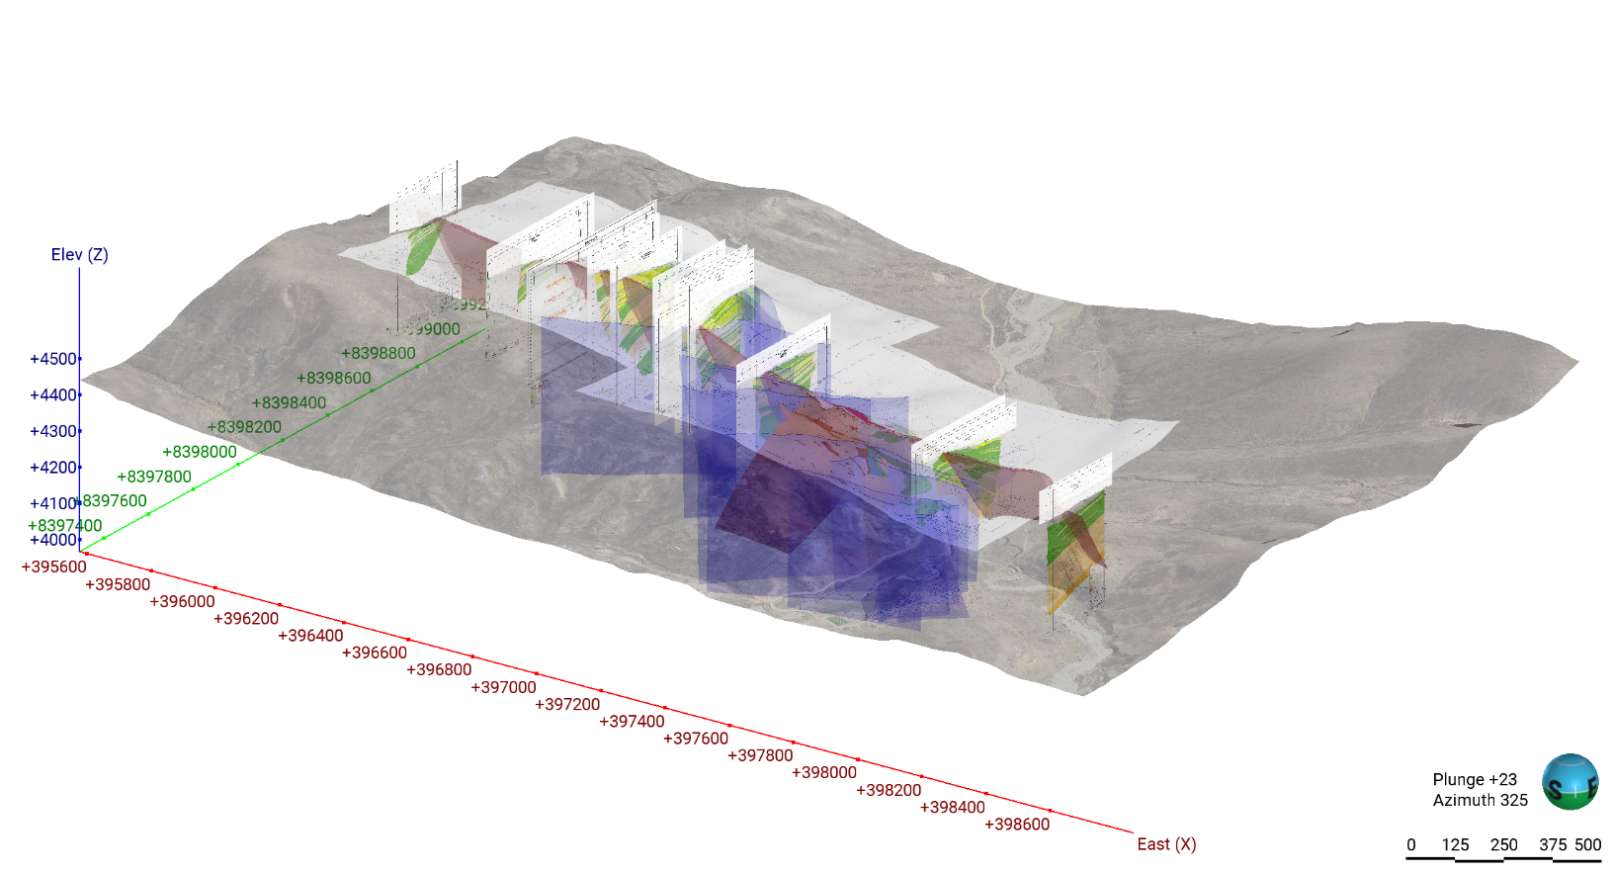
Geological Modeling potential to grow 2X plus in size
Preliminary Geological Modeling of La Princesa Vein, from which the Historical Resource was drilled, related vein splays and crosscutting structures was carried out based on surface maps and cross sections
Robust Initial Size: La Princesa Vein envelope has a volume of 8.4 Mm³ with a minimum thickness of 1.2m and stretches for 2.2 km along strike.
2X or greater Size Potential of Known Deposit : La Princesa Vein tonnage potential is 23.1 Mt considering a uniform density of 2.75 g/cm³.

Slide 9
HIGH-GRADE SILVER INTERCEPTS
HOLE | FROM (m) | TO (m) | INTERSECTION¹ (m) | SILVER (g/t) | LEAD (%) | ZINC (%)
PRIN06-02 | 121.0 | 155.0 | 34.0 | 66.1 | 1.08 | 1.60
PRIN06-05 | 3.5 | 36.2 | 32.7 | 93.2 | 1.45 | 1.33
PRIN06-09 | 6.8 | 24.2 | 17.4 | 86.4 | 2.48 | 0.18
PRIN06-11 | 40.8 | 55.8 | 15.0 | 214.5 | 1.17 | 0.67
PRIN07-53 | 61.1 | 73.6 | 12.5 | 570.4 | 2.50 | 1.02
PRIN07-61 | 91.5 | 109.5 | 18.0 | 174.0 | 5.02 | 1.76
Note: Intersections are reported as core lengths and are not necessarily true thickness. Refer to NI 43-101 technical report on the La Princesa Property prepared for Alcon Silver (Chance, June 24, 2024) available online at SEDAR+. All technical information was derived from drill campaigns completed by Caracara Silver (2006-2013) and subject to QAQC protocols administered by CaracaraSilver.

Slide 10
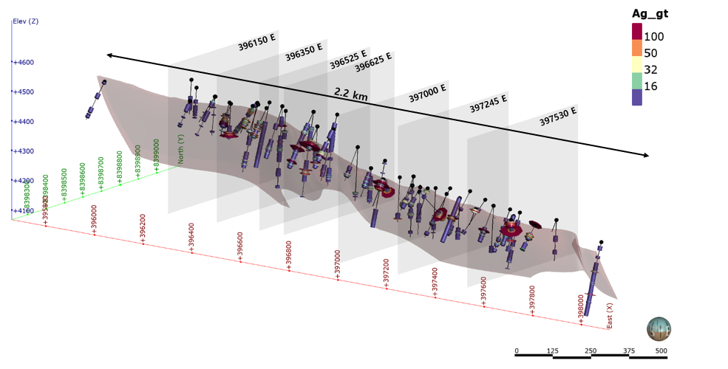
Drill results long Section
Highlights of drilling results are herein presented as N-S oriented long section

Slide 11
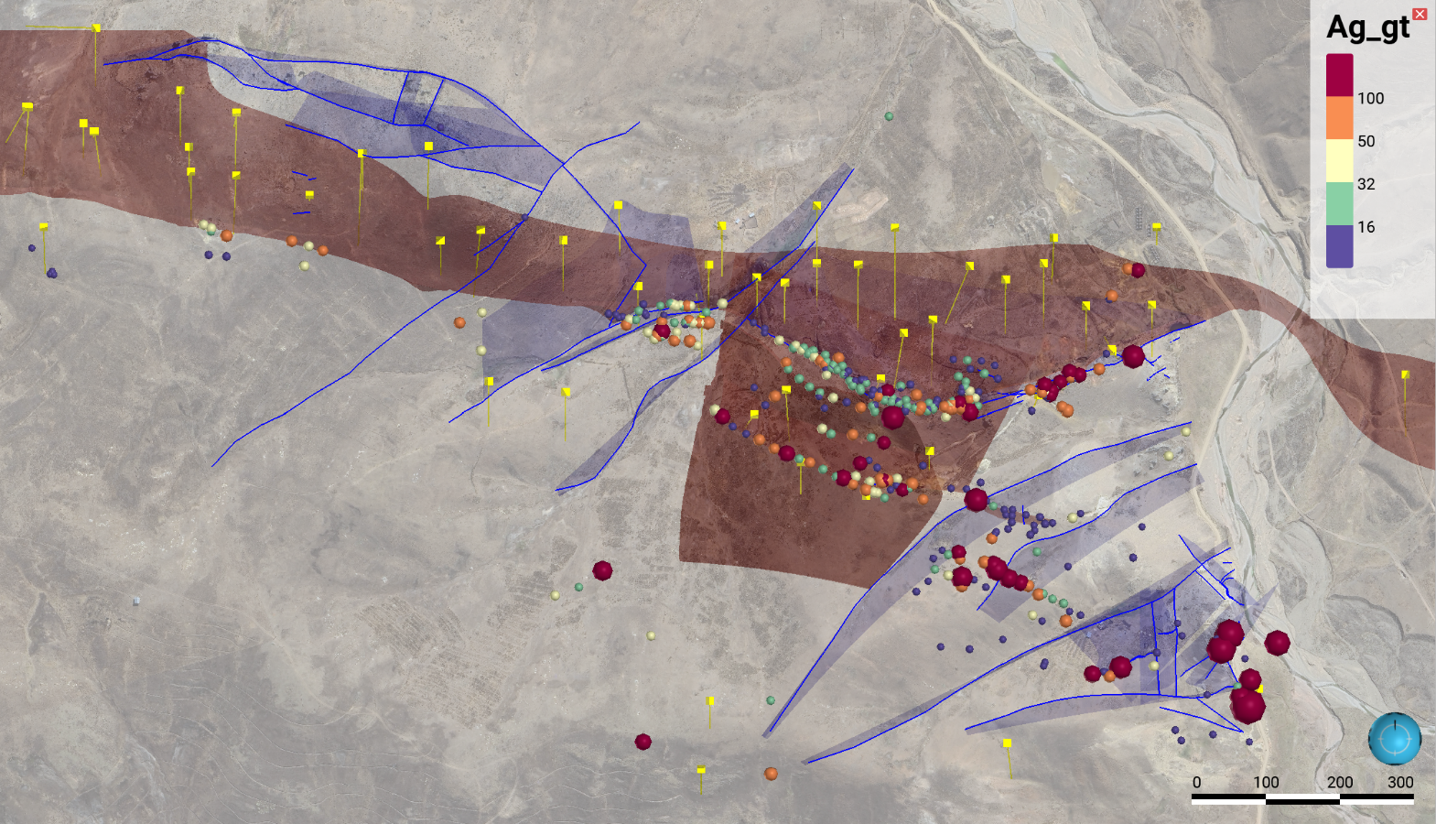
Princesa Expansion Target SURFACE GEOCHEMISTRY - silver
N
La Princesa Vein wireframe
Vein facing east-southeast, showing clayey-looking Huancané conglomerates forming walls to darker, well defined mineralized structure.
Existing
Drilling
Untested Southeast Princesa Expansion Target
Mapped
Structures
Mineralization
Trends

Slide 12
PRINCESA DEPOSIT AND EXPANSION TARGET CATALYSTS
NEXT STEPS:
Realize Princesa Deposit Growth Potential - 4500m Infill/Step Out Drill Program
Test Princesa Expansion Target - 1500m Drill Program
4

Slide 13
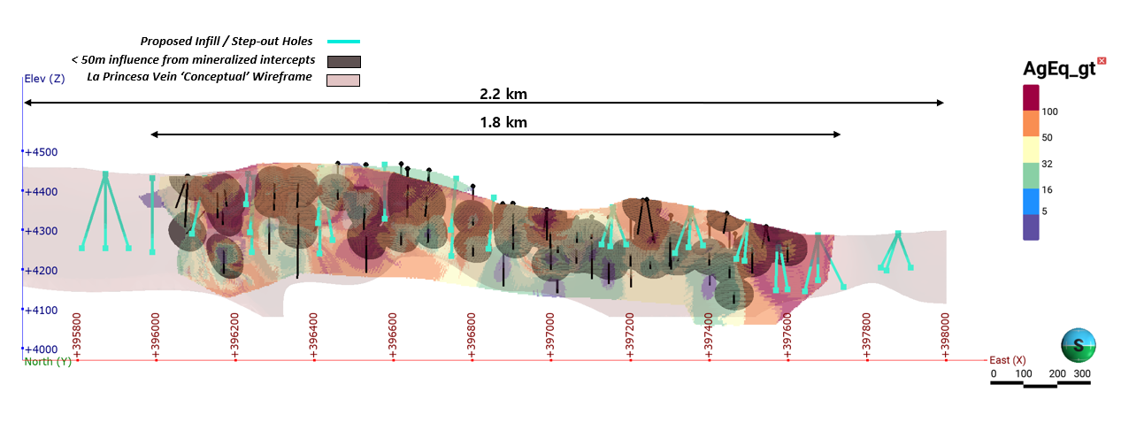
PROPOSED INFILL / STEP-OUT DRILL PROGRAM
A 4,540m drill program consisting of 31 holes averaging 150m depth drilled from 15 pads in a fan array is proposed to infill gaps in the historical drill zone, while working towards improving the resource categorization from inferred to indicated as well as step-out holes to test mineralization laterally along La Princesa vein.
Vein facing east-southeast, showing clayey-looking Huancané conglomerates forming walls to darker, well defined mineralized structure.

Slide 14
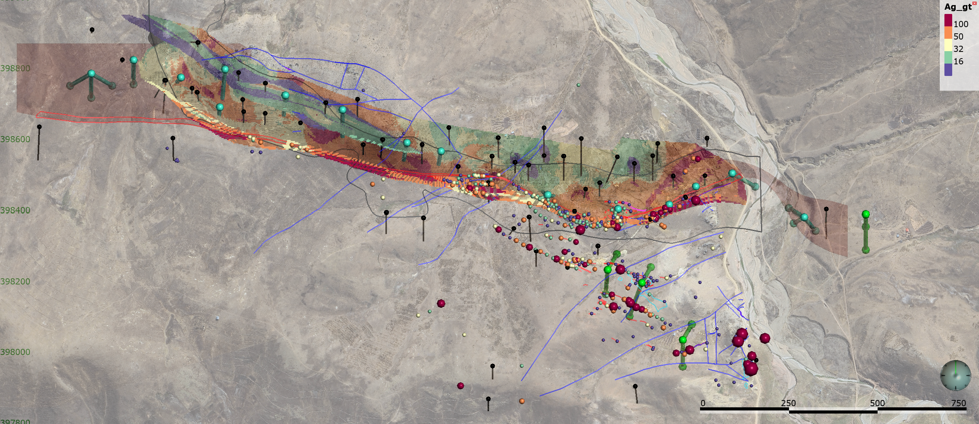
PROPOSED TARGETING DRILL PROGRAM
A 1,550m drill program consisting of 9 holes averaging 170m depth drilled from 4 pads in a fan array is proposed to test mineralization at the Southeast Target over limestone and vein outcrops as well as across the river to the east side.
Vein facing east-southeast, showing clayey-looking Huancané conglomerates forming walls to darker, well defined mineralized structure.

Slide 15
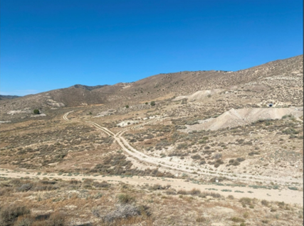
The Star CRD Project, First Mover Advantage
Look Southwest from Harrington – Hickory Mine at Numerous Mines and Pits
Development in the Permian Limestone along the Western Flank of the Star Graben.
15

Slide 16
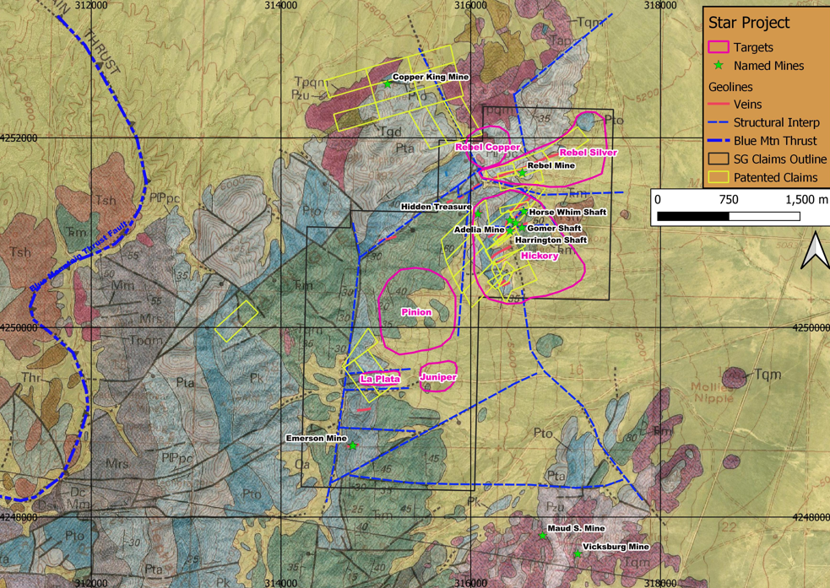
Star Project – A Silver crd Project In An Historic Mining District
800 hectares of lode claims located on the eastern flank of the Star Range in Southern Utah.
The claim block covers an area that forms a "3 sided graben" block of sedimentary rocks. Grabens often provide a closed environment for circulating hydrothermal fluids...an excellent environment to explore for buried CRD's
The Milford Mine (copper, US $100m upgrade underway) is only 7 miles to the north of Star.
Recently miners including Kinross, Anglo Gold and Electrum Group entered the district.

Slide 17
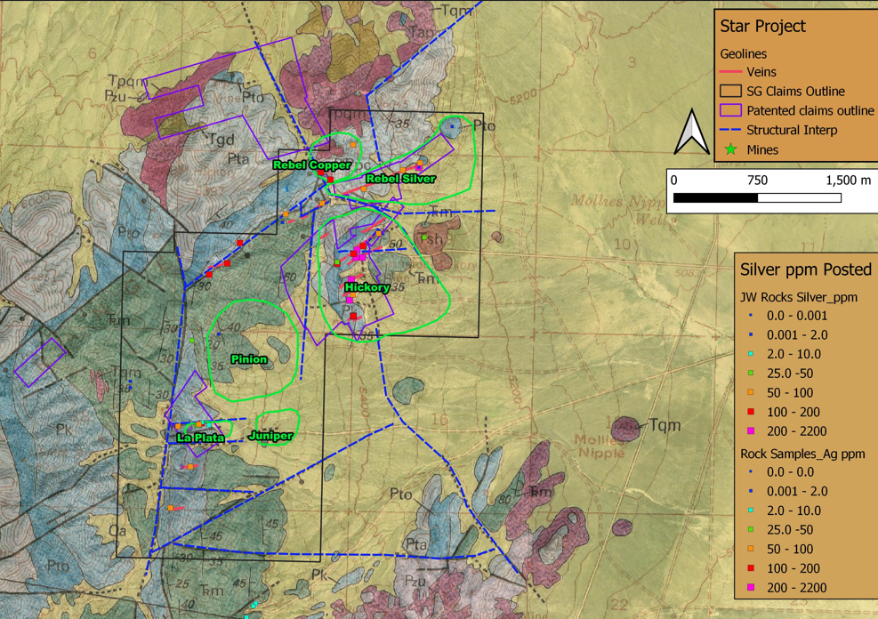
Rebel Silver-A Primary Drill Target
The Rebel Silver Target focuses on the NE vein extension into a CRD type chimney structure.
The chimney host rock is Toroweap limestone.
Excellent potential to find larger CRD's at depth in the Toroweap Limestone.
Vein facing east-southeast, showing clayey-looking Huancané conglomerates forming walls to darker, well defined mineralized structure.

Slide 18
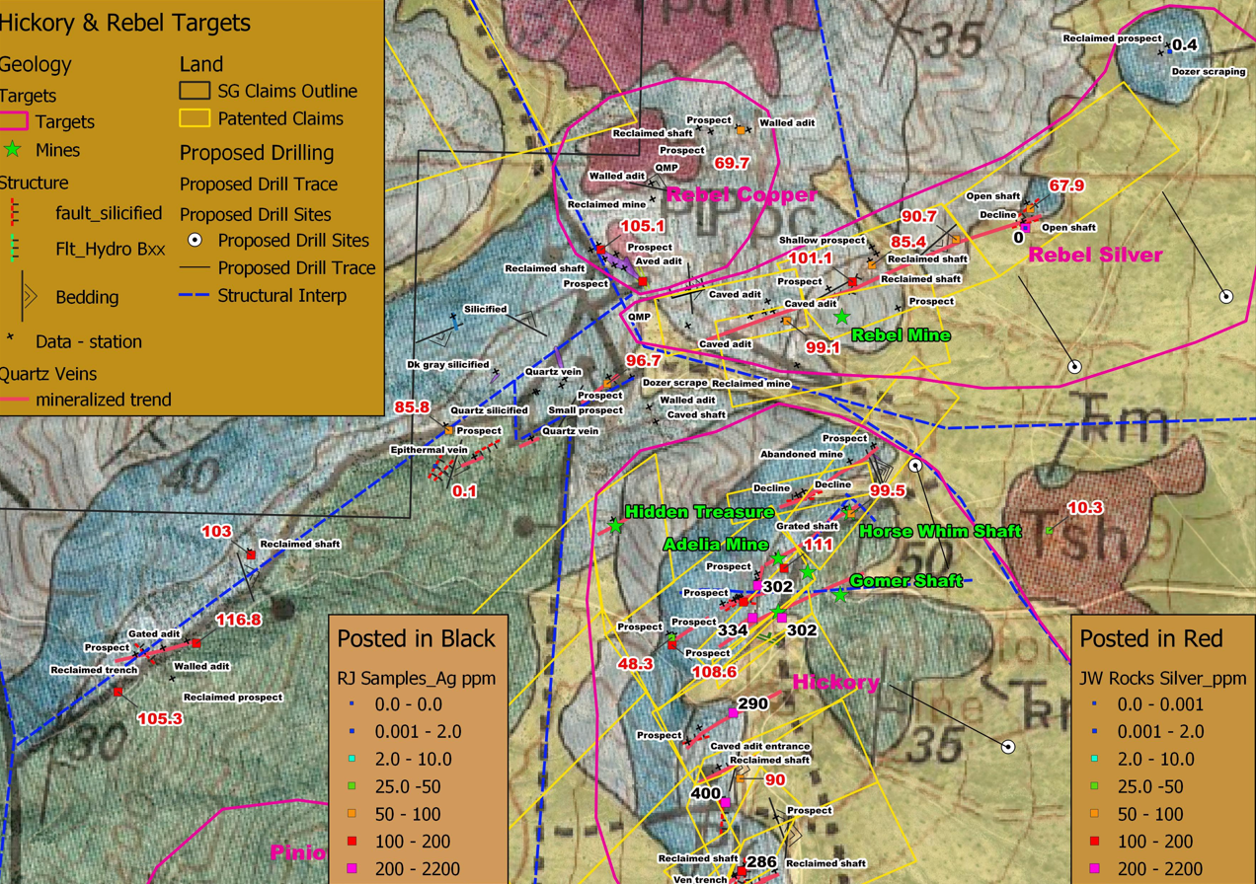
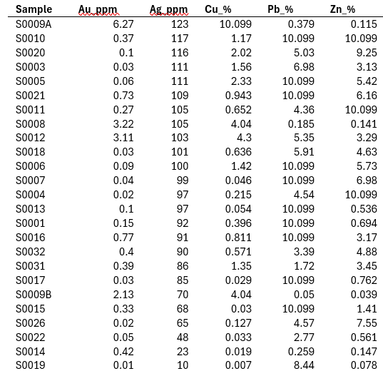
Hickory Rebel Targets

Slide 19
STAR PROJECT CATALYSTS TO FIRST DRILL PROGRAM
Phase 2 of land mapping and geochemistry at the Rebel and Hickory Mine target zones
Begin land access agreements with patented claimholders
Airborne ground magnetics survey
Conduct gravity survey
Apply for drill permits Q1 2026
Continue staking targeting NW copper zone

Slide 20
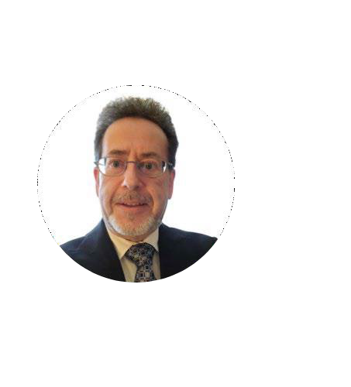
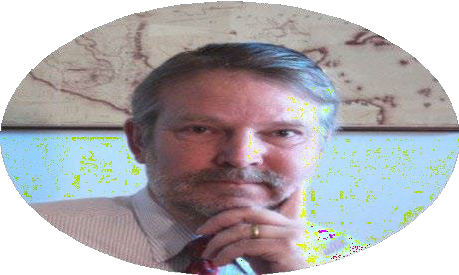
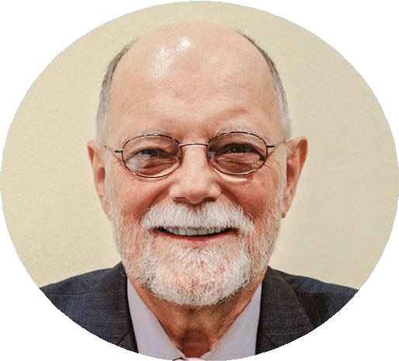
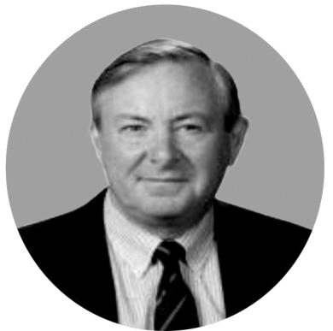




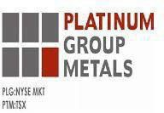


PROVEN MINE FINDERS
Robert Tyson
President & CEO, Director
Dr. John E. Larson, M. Sc.,Ph.D.
Director
Former Leader - Global Porphyry Copper Exploration, and Manager - Latin America Exploration with BHP Biliton. Corporate Manager Exploration– Hochschild MiningPLC.
Over 35 years of experience as a senior executive and director with numerous publicly traded technology and mineral exploration companies based in Canada and the United States and Latin America.
Previously President/CEO of Cue Resources and Source Exploration and Vice President, Corporate Development with Minco Silver and Solex Resources (former registered owner of the La Princesa Project)
Bruce Winfield, M.Sc.,P.Geo.
Director
Tim Marlow, C.Eng.
Director
Over 40 years of experiencein the miningindustry with focus in Central America and Mexico.
Former VP Explorationfor Greenstone Resources and Eldorado Gold Corp. leading to the exploration and development of five gold deposits.
More than 30 years of mining engineering and mine operating experience in North America, South America, Africa and Asia.
Previously Vice President of Operating Excellenceat Hochschild Mining.
Currently a director of PlatinumGroup Metals Ltd.
NI 43-101 Independent Qualified Persons:
Steven L. Park: Graduated Mackay School of Mines at the University of Nevada-Reno, 1983, M.Sc. in Economic Geology. Mr. Park has practiced as a professional geologist more than 30 years in the Americas including more that 20 years continuous exploration experience in Peru. Mr. Park is a member in good standing with the American Institute of Professional Geologists and is a Certified Professional Geologist.
Patrick N. Chance: Graduated in 1975 from Queen's University at Kingston with a B.Sc. (Applied Science) in geological Engineering and graduated from the University of Western Ontario with a M.Sc. in geology in 1981. Mr. Chance is a Professional Engineer in the province of Ontario and has practiced as an exploration geologist for 41 years including with the Mina Tintaya porphyry-skarn resource development project in Peru.
20

Slide 21

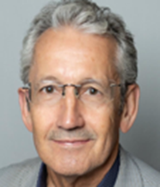
PROVEN ADVISORS
Darrell Rader, BBA
Having directly raised over $100 million for mineral exploration and development, Mr. Rader has significant contacts with institutional investors and bankers. Mr. Rader is the founder of Defiance Silver Corp., an advanced Mexican silver explorer. He previously served as the Manager of Corporate Development for IMPACT Silver Corp that was transformed from a grass roots silver explorer into a profitable silver miner. Currently President & CEO, Director of Minaurum Gold Inc.
Joey Wilkins, P.Geo
Joey Wilkins is a porophyry exploration specialist with deep experience across the Americas, including leadership roles at Kennecott Exploration (Rio Tinto), Coeur Mining, and Aztec Minerals. Joey has extensive experience in porphyry Cu-Mo, epithermal Au, Magmatic Ni-Cu, and industrial minerals, spanning discovery through advanced targeting.
21

Slide 22
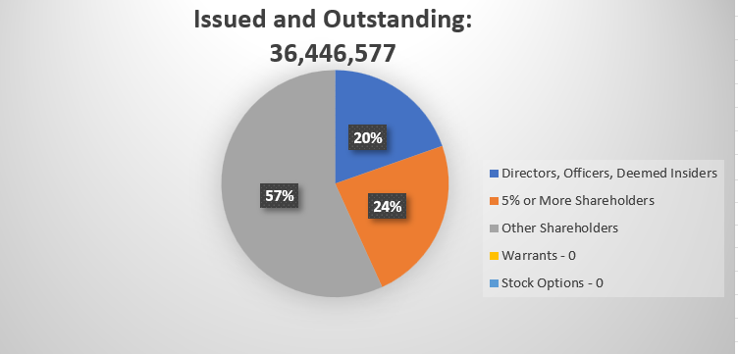

SHARE CAPITAL STRUCTURE
22

Slide 23


Robert Tyson
President & CEO
Phone 604.315.1400
Email rtyson@alconsilver.com

